Slide 1
Portable and Performant GPU/Heterogeneous Asynchronous Many-Task Runtime System
Ph.D. Research Proposal Brad Peterson

Slide 2
Research Question
Can an HPC software model automatically prepare simulation variables, efficiently execute code on multiple architectures, and allow for only one portable codebase supporting GPUs, CPUs, and Xeon Phis?
Challenges
Nvidia GPUs use a separate CUDA programming model, making one codebase more difficult.
Need GPU asynchrony for data movement and execution to avoid bulk synchronous model issues.
Heterogeneous mixtures of code (e.g. some loops written for CPUs, others for GPUs).
GPUs add more memory spaces, requiring new data movement and halo gathering strategies.
Portability tools may have limited features, high overhead, and may not support all architectures.

Slide 3
Research Approach
For scheduling and execution of code, use an asynchronous many task runtime.
AMTs automatically schedules and execute tasks. Supports large scale parallelism.
This research uses Uintah.
For writing code loops, use a portability tool:
Task loops written once and later executed on CPUs, GPUs, Xeon Phis, and/or other architectures.
May also provide architecture-aware data structures, looping strategies, and portable software libraries.
This research uses Kokkos.
Challenges addressed here:
Uintah’s prior GPU model lacked task asynchrony, data store variable concurrency, efficient data movement among memory spaces, and efficient task execution.
Kokkos lacked GPU asynchrony.

Slide 4
Novel Aspects of Research
Uintah is the first AMT embracing automated asynchronous halo gathering API on the GPU.
(WolfHPC’15 paper, ESPM2’17 paper, IJPP’16 journal in progress.)
Make Uintah the first AMT embracing GPU code portability in its API.
(ESPM2’16 paper, RESPA’15 paper, JoCS’18 journal in progress.)
Make Kokkos the most efficient tool utilizing functors for GPU asynchronous portability.
Early results indicate this is possible.
Make Kokkos the first portability tool targeting CPUs , GPUs, and Xeon Phis providing parallel_for and parallel reduce_loops fully avoiding synchronization.
Early results indicate this is possible.

Slide 5
Outline
Uintah Overview
Comparison with other AMT runtimes
Portability tools overview
Prior Uintah GPU work, its issues, my solutions, and results
Smaller, asynchronous, concurrent GPU data store [WolfHPC’15]
Automatic halo gathering in GPU memory [WolfHPC’15, ESPM2’17, IJPP’16]
Sharing simulation variables among tasks [WolfHPC’15, IJPP’16]
Sharing large halo dependencies [ESPM2’17]
Kokkos overview and its GPU bulk synchronous issues.
Asynchronous execution of functors for parallel_for and parallel_reduce loops
All remaining work required to address the research question.

Slide 6
Section 1 – Uintah Overview

Slide 7
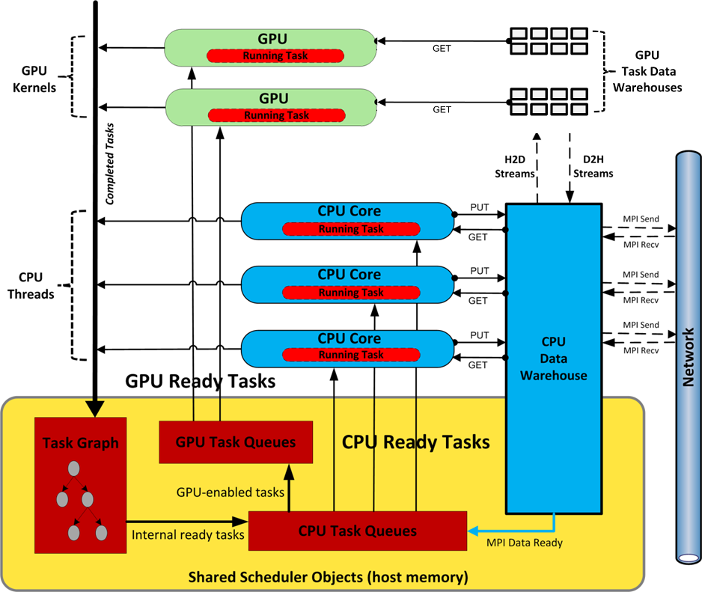
Uintah Overview
Shared memory model on-node
1 MPI rank per node
MPI + Pthreads + CUDA
Better load-balancing (node-level)
Decentralized: All threads
access CPU/GPU task queues
implicit work stealing
process their own MPI
interface with GPUs
Scalable, lock-free data structures
Task code must be thread-safe

Slide 8
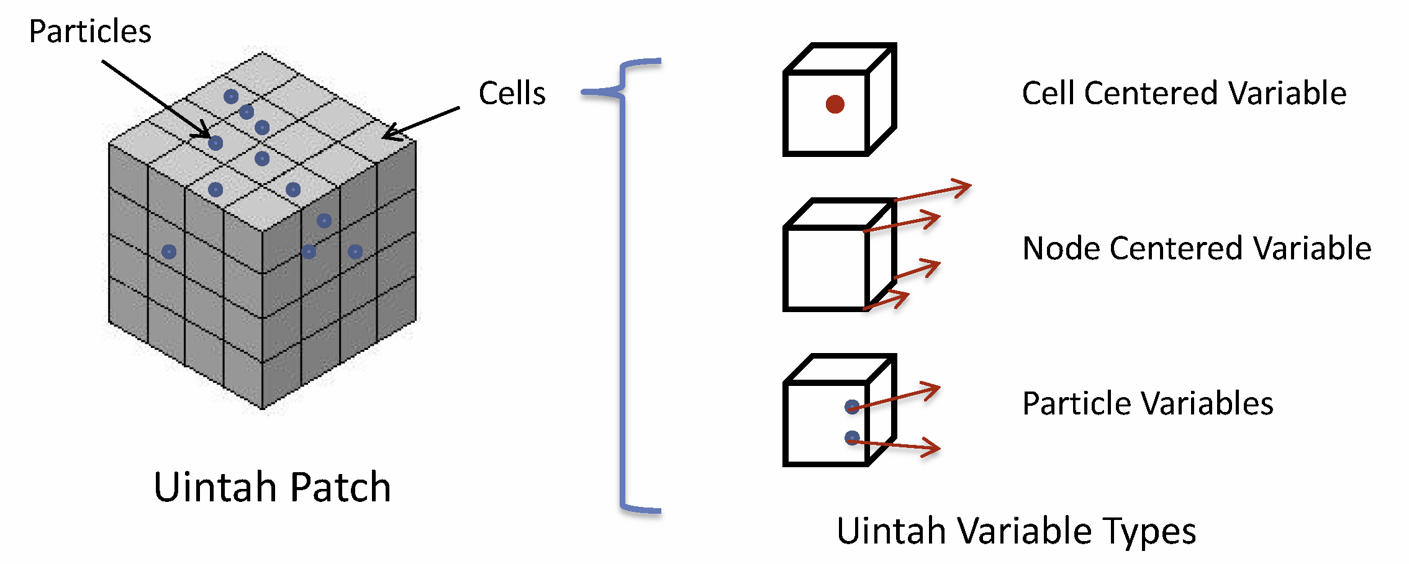
What is a Patch?
Structured grid decomposed into patches
Unit work space – block structured collection of cells with I,J,K indexing
Patches uniquely assigned to cores
Structured GridVariable (for Flows) are Cell, Face, Node Centered
Unstructured Points (for Solids) are Particles or ParticleVariables
Variables live on patches (cells)
A Task?
Basic unit of work within Uintah – granularity user determined
C++ method with computation (user written callback)
A specification of inputs/outputs with halo requirements
Interacts with local data repository – DataWarehouse
DataWarehouse provides a simple get(), put() interface
Scheduled and executed via Task-Scheduler

Slide 9
Example: Uintah Model for Stencil Timestep
Network
Example Stencil Task
Halo sends
Unew = Uold +
dt *F(Uold, Uhalo);
Old Data
Warehouse
GET Uold/Uhalo
MPI
New Data
Warehouse
PUT Unew
Halo receives Uhalo
User specifies
patch variables
halo levels
and connections

Slide 10
Section 2 – Comparison with Other AMT Runtimes

Slide 11
Comparison With Other Runtimes
Runtime | Common Usage | Developer involvement with runtime | Automatic internodal data movement | Automatic halo gathering | Runtime data store | Automatic data sharing among tasks | GPU support | Portable code for CPU and GPU tasks
Uintah | Multiphysics - adaptive mesh grid | Light | Yes – local memory/MPI | Host mem. (This work for GPU) | Host mem. (This work for GPU) | This work | Yes (This work for performance) | This work
Charm++ | Generalized tool / Load balancing | Medium | Invoked by user | No | No | No | With add-ons | Weak (add-ons required)
Legion | Generalized tool | Heavy | Yes – global memory | Yes (requires extensive definitions) | No | Yes | Yes | No
HPX | Generalized tool / Standards based design | Medium | Yes – global memory | No | No | No | No | No
PaRSEC | Linear Algebra | Medium | Yes | Yes | No | Yes | Yes | No
StarPU | Linear Algebra | Medium | No | No | No | Yes | Yes | No

Slide 12
Section 3 – Portability Tools Overview

Slide 13
Comparison of Portability Tools
Tool | Portability approach | Data Variable Portability | Performance | Weaknesses | Portability Tools For Application Developers
Kokkos | Functors and templates | Extensive! Layout, dimensioning, tiling, subviews | Avoids indirection. Loops and layout can match architecture. | GPU is bulk synchronous (This work fixes that) | Random number generation, vectors, unordered maps, etc.
RAJA | Functors and templates | In development with CHAI, Sidr, and Umpire | Avoids indirection | Less mature than Kokkos, many more non-portable hacks. Synchronization on GPU reductions. | None
OpenACC | Compiler and pragmas | Basic | Compiler directives. Compiler optimization. Forces simpler Fortran-like design. | No strong Xeon Phi KNL support. Synchronization on GPU reductions. Pragma bloat. | None
OpenMP | Compiler and pragmas | Basic | Compiler directives. Compiler optimization. Forces simpler Fortran-like design. | GPU options and performance limited. Pragma bloat. | None
OpenCL | CUDA-like syntax and compiler | Basic | Large performance penalty frequently observed. | Performance and uncertain future. | User libraries?

Slide 14
Section 4 – Prior and Current Uintah Work

Slide 15

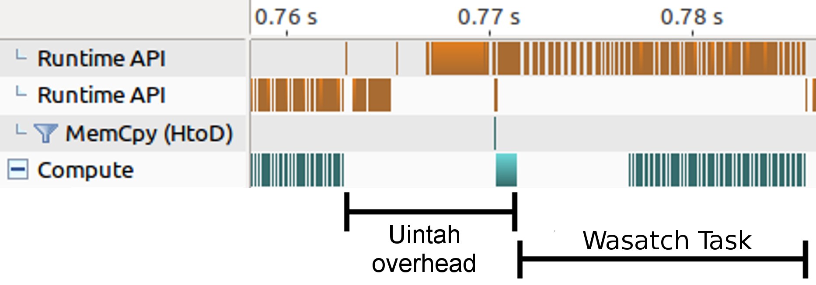
Before My Research: Prior Uintah GPU runtime
Synchronized memory copies
Proof of concept
Bulk synchronous
Runtime simulation variable management:
All halo gathers occur in host memory
Allocate and copy all simulation variables into GPU memory
Copy large, monolithic GPU Data Store host-to-device
Copy all computed data from GPU into host memory
Duplicated codebases (CPU and CUDA) common.
GPU tasks had to be manually configured and launched inside a CPU task
Serialized and synchronized execution of GPU tasks
Data store copies added to large overhead for short-lived tasks

Slide 16
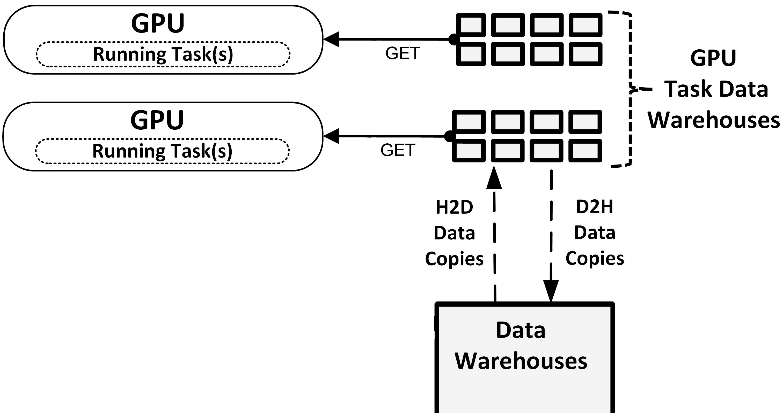
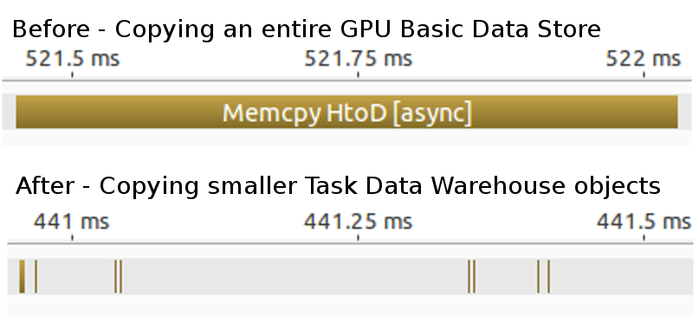
Task GPU Data Warehouse
Problem: Monolithic and shared GPU Data Store bad for asynchrony, concurrency, and copy overhead.
Solution: Now each GPU task receives its own data warehouse.
Much smaller (see figure on right)
Avoids concurrency entirely and great for asynchrony.
Programmability benefit: application developers can only access simulation variables they indicated they would.

Slide 17
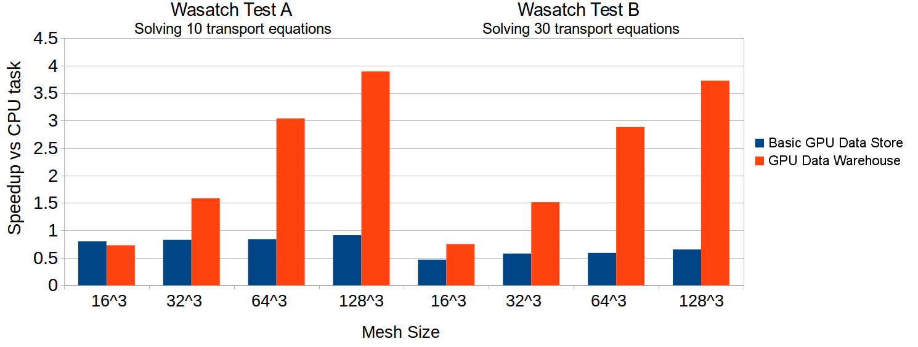
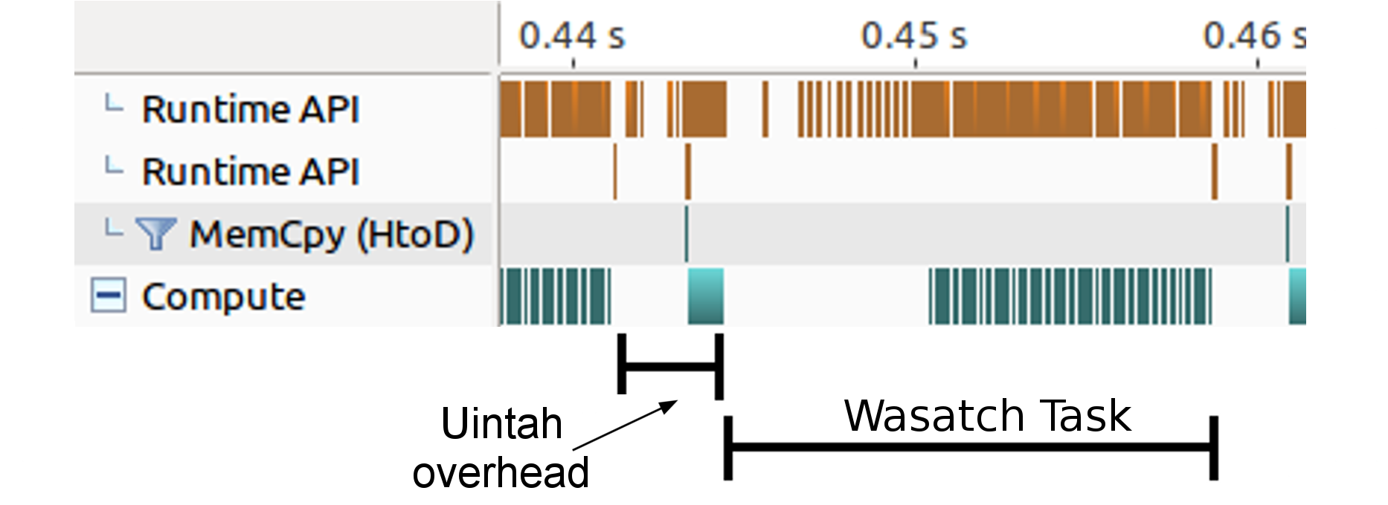
Tasks Dictate Data Persistence
Task scheduler keeps simulation variables in GPU memory as long as possible (avoids frequent host-to-GPU and GPU-to-host transfers)
Halo gathers occur within GPU memory if possible.
Before:
After:
Wasatch tasks solving 10 and 30 transport PDEs respectively. Computations performed on a Nvidia GTX 680 GPU and an Intel Xeon E5-2620.
Notes:
Dynamic task graph ready

Slide 18
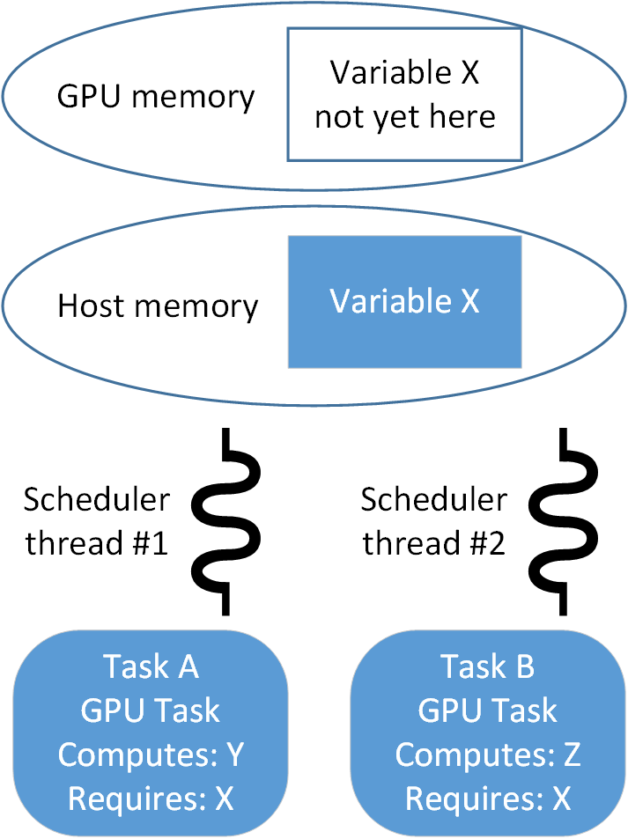
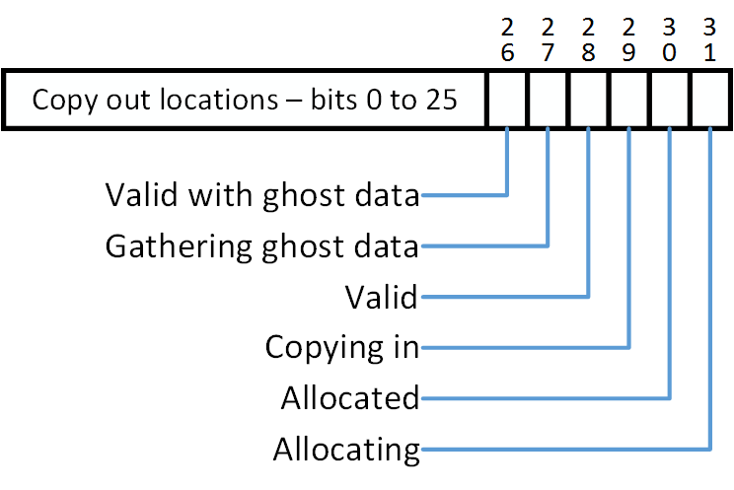
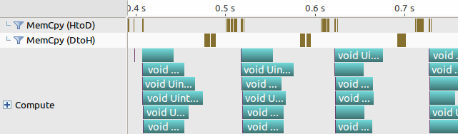
Data Sharing Among Tasks
Problem: Two scheduler threads are assigned a different task to analyze. Each requires X in GPU memory, but it is not yet there.
Status bitset assigned for each simulation variable. Allows scheduler threads to coordinate using atomic operations.
This was the last synchronization piece. Now kernels can overlap in the GPU!
Solution: Task scheduler threads now coordinate with one another. Above example: X is only copied once into GPU, and both tasks share it.
Notes:
Other schedulers use something similar to a cache coherency protocol. That requires a “snooping” approach.

Slide 19
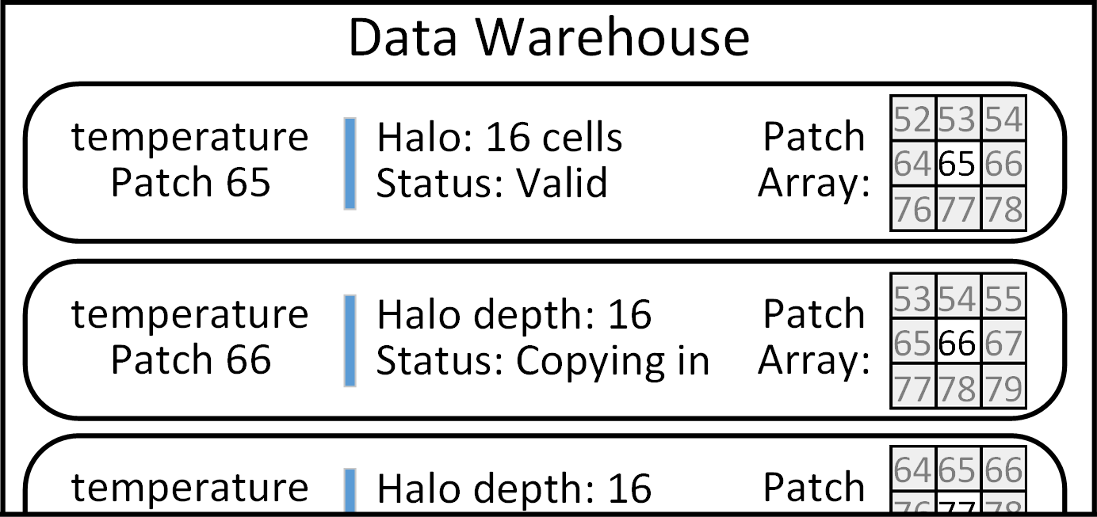
Data Sharing Among Data Dependencies
Recent Titan production run of a propose high efficiency coal boiler had global data dependencies.
Problem: Prior work could share a simulation variable among tasks, but not its halo data.
Duplication of data prevented problem fitting within GPU memory!
For example: Patch 66 duplicated three times

Slide 20
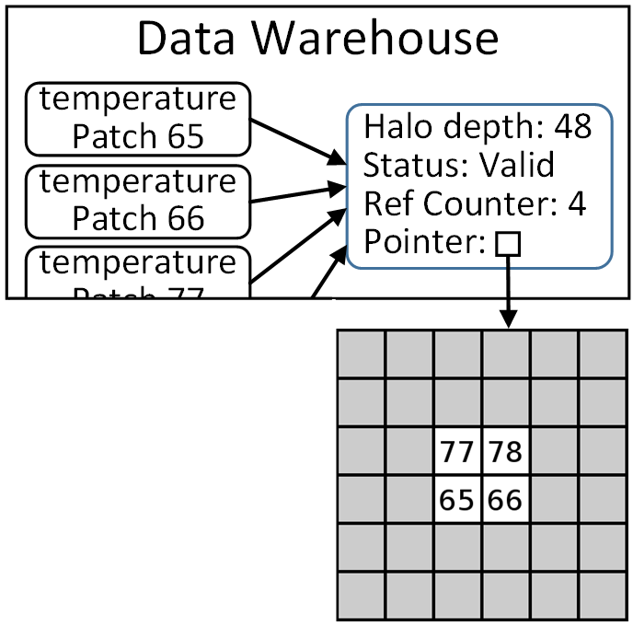
Data Sharing Among Data Dependencies
Task scheduler and data warehouse changes facilitated a halo sharing mechanism.
Dynamic and retains asynchrony.
Production problem fit into GPU memory!
Memory Overhead Improvements
Simulation Patch Layout | Host memory usage before (MB) | Host memory usage after (MB)
Coarse: 32³ cells, 4³ patches Fine: 64³ cells, 4³ patches | 3073 | 65
Coarse: 32³ cells, 4³ patches Fine: 128³ cells, 4³ patches | 23229 | 279
Coarse: 64³ cells, 4³ patches Fine: 128³ cells, 4³ patches | Exceeded memory | 311
Example follow-up: Patch 66 isn’t duplicated!
Memory usage for a production problem for computing radiative heat transfer.

Slide 21
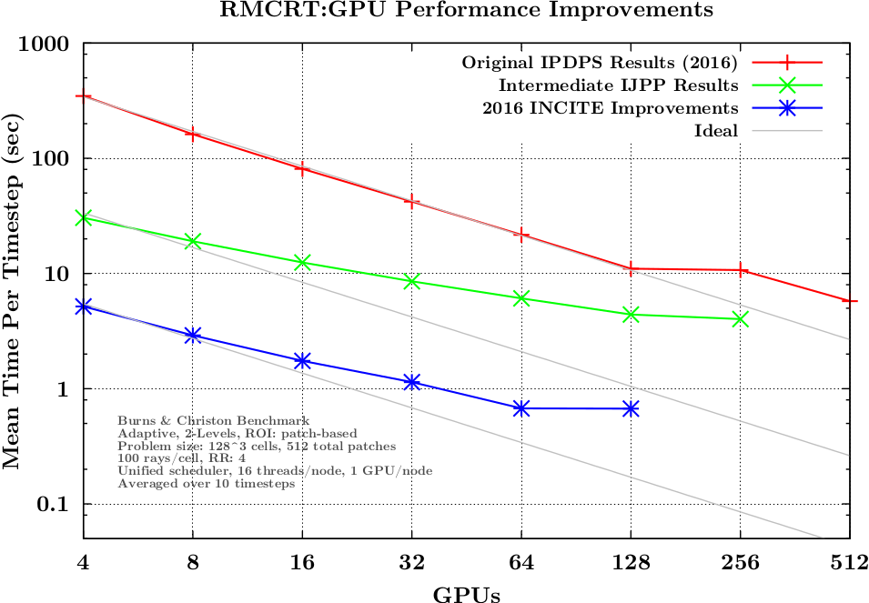
Uintah Improvements
Prior runtime enhancements have significantly reduced copy overhead.
Tasks do a much better job fully occupying a GPU.

Slide 22
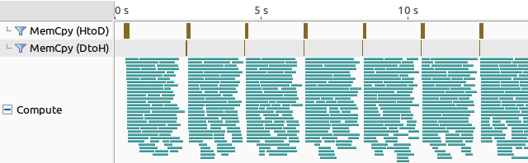
Splitting Tasks into Multiple Streams and Kernels
Problem: Tasks with larger patches are difficult to distribute among a GPU. But tasks with small patches add more runtime overhead.
Finer grained tasks aren’t always the answer!
Solution: A compromise is splitting tasks into multiple kernels, each launched on its own stream.
The runtime now supports managing multiple streams per task. Almost 100 streams shown below!
RMCRT GPU tasks using 300 rays in a 28x28x56 cell domain in 16 patches - 8 CPU threads, 6 streams per kernel on a Nvidia K20c GPU

Slide 23
Section 5 – Kokkos Work

Slide 24
Kokkos
Compiles and runs on multiple architectures
Obtains performant memory access patterns via architecture-aware arrays and work mapping
Can leverage architecture-speciﬁc features where possible.
Loops using functors/lambdas for portability: Kokkos::parallel_for ( Kokkos::RangePolicy<Kokkos::Cuda>(0,256), my_functor());
Views:
Kokkos::View<double[10][3]> my_view;
Tools: Kokkos::RandomXorShift64Pool<> rand_pool( 1313 );
rnd_type rand_gen = rand_pool.get_state(); double my_random_Number = Kokkos::rand<rnd_type, double>::draw(rand_gen);
Notes:
Functors are the heart of Kokkos code portability.
RAJA, Nvidia Thrust, Hemi-2 use functors as well for GPUs

Slide 25
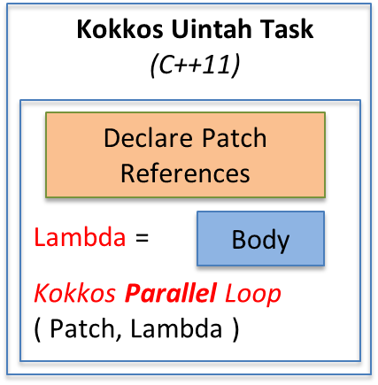
Example: Uintah Model for Stencil Timestep
Network
Example Stencil Task
Halo sends
Unew = Uold +
dt *F(Uold, Uhalo);
Old Data
Warehouse
GET Uold/Uhalo
MPI
New Data
Warehouse
PUT Unew
Halo receives Uhalo
Kokkos Views Memory Structure
Use Kokkos abstraction layer: Maps loops for architecture-aware memory access patterns

Slide 26
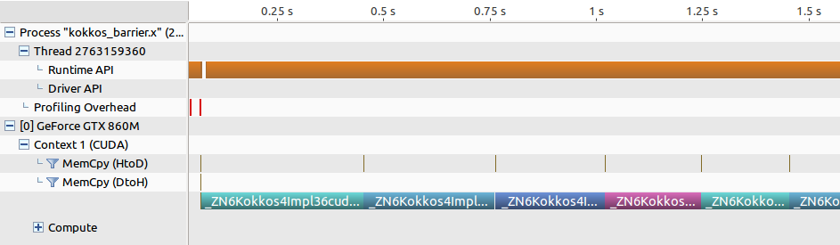
Kokkos for GPUs
Problem: Kokkos is bulk synchronous on the GPU! All copies and kernels synchronize.
No way to request or supply streams or invoke asynchronous actions.
Notes:
The functor is the heart of Kokkos

Slide 27
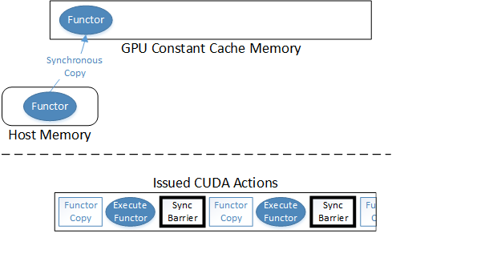
Kokkos Functors and GPUs
For GPUs, if the functor is large, Kokkos places the functor is placed into GPU Constant Cache Memory.
GPU Constant Cache Memory acts as read-only registers.
Kokkos executes the functor inside a kernel.

Slide 28
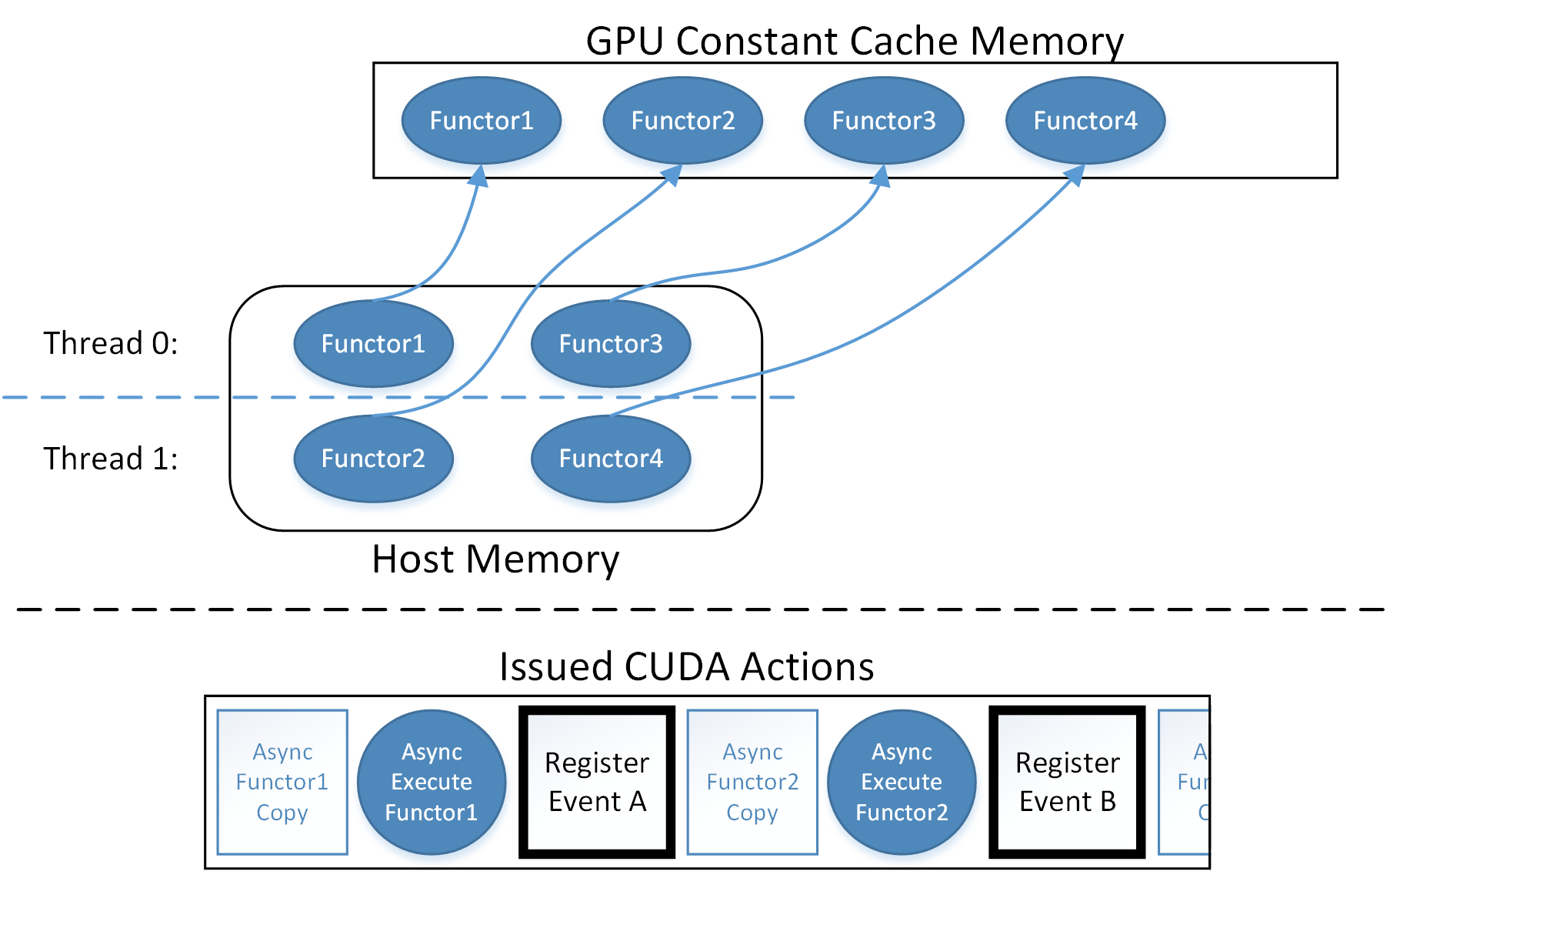
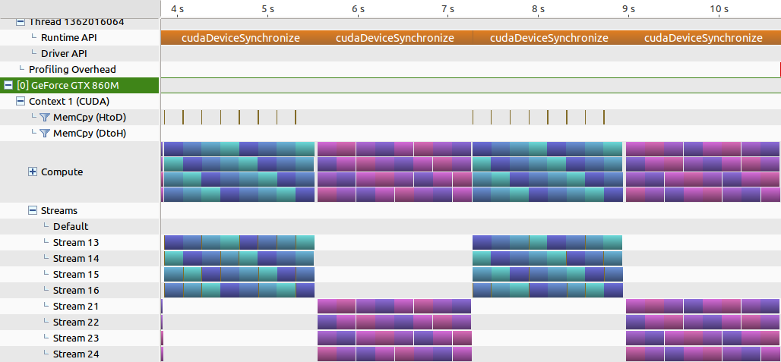
Modifying Kokkos for Multiple Asynchronous Functors
I implemented a lock free allocation bitmap for functors.
If the bitmap is full of functors, Kokkos checks all CUDA events to see if a prior functor completed, then can free that constant cache space.
Results of Kokkos modifications: Blue is Kokkos::parallel_for Purple is equivalent CUDA code
Notes:
CUDA streams not shown yet…

Slide 29
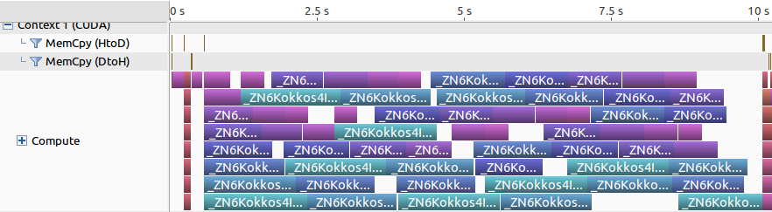
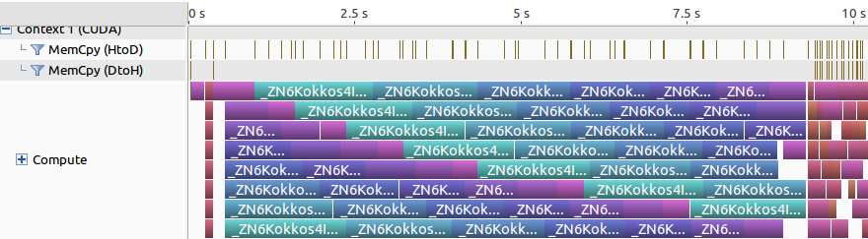
Current Kokkos Results
Using constant cache memory for functors is ideal for overlapping kernels
To the best of my knowledge, nobody has observed this before.
Using GPU local memory only for functors. Occasional synchronization occurs.
Using GPU constant memory only for functors. No synchronization!

Slide 30
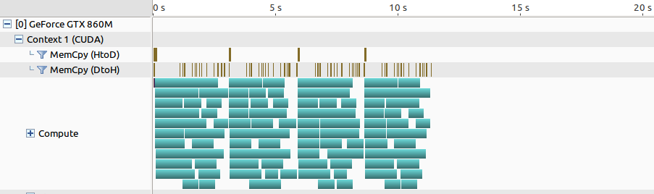
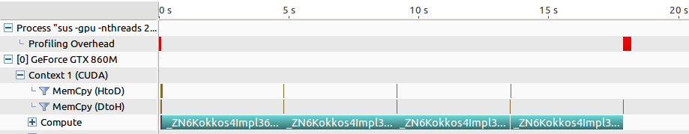
Kokkos - GPU Parallel Reduce
Much more going on under-the-hood compared to a Kokkos::parallel_for.
Biggest asynchrony issue: The reduction value
Pinned memory for GPU-to-host copy is crucial (Kokkos can be modified to automatically manage this.)
RAJA and OpenACC synchronize when copying the reduction result into host memory.
Work is 60-75% complete.
Before: Before Kokkos modifications. Production and portable code. Letting the GPU partition 1 large patch.
After: After Kokkos + Uintah modifications Production problem! It’s portable code! It’s faster than bulk synchronous!

Slide 31
Section 6 – Remaining Work

Slide 32
Future Work – Data Management Performance
OnDemand Data Warehouse’s halo gathering makes duplicates of variables.
Derek Harris is currently having big problems with this.
Should use GPU Data Warehouse model for simulation variable:
Sharing among tasks
Pre-sizing
Pre-allocating
GPU Data Warehouse gathers in halo cells through GPU kernels.
Both James Sutherland and I have noticed this is not as fast as we want.

Slide 33
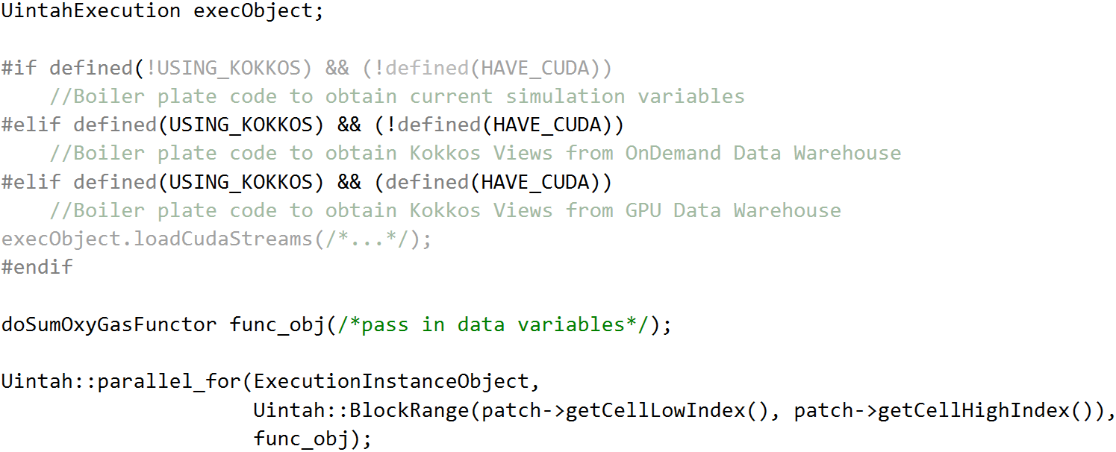
Future Work – Data Management Portability
Currently, ugly and non-portable preprocessor directives needed to retrieve simulation variables.
Goal: Application developers shouldn’t have to do this!

Slide 34
Constraints of Future Work
Focus on tasks already written with Kokkos code.
RMCRT and Arches tasks are the current target Kokkos problems.
Will not rewrite existing CPU tasks into Kokkos, with the exception of RMCRT.
Some tasks can’t port if they depart from Uintah conventions or use non-portable code (e.g. STL containers, system calls, etc.)
Require minimal architecture specific #ifdef stubs for application developers.
Exception: Looping ranges require architecture specific fine tuning.
It’s possible some data warehouse usage will be non-portable (e.g. Todd Harman likes the getRegion() API which can’t be GPU portable).

Slide 35
Thesis Outline
Abstract
Chapter 1 Introduction
Chapter 2 Related Runtimes and Tools
Chapter 3 Uintah Overview and Application Developer API
Chapter 4 A Host and GPU Data Store Enabling Concurrency, Asynchrony, and Data Sharing
Chapter 5 Uintah Heterogeneous/GPU Task Scheduling and Execution
Chapter 6 Kokkos Code Modifications for Asynchrony of Data Movement and Execution
Chapter 7 Kokkos and GPU Integration Into Uintah
Chapter 8 Conclusions and Future Work
Appendix
References

Slide 36
Thesis Plan
November-December 2017: Finish Kokkos work on parallel_for, parallel_reduce, and supporting tools. Demonstrate Kokkos with RMCRT in Uintah with various codebases. Write Abstract and Chapters 6 and 7 of the dissertation.
January 2018: Begin transitioning to a unified data warehouse model. Finish Abstract, Chapter 1 Introduction, Chapter 2 Related Frameworks and Tools, and begin Chapter 3 Uintah Overview and Application Developer API.
February 2018: Continue implementing a unified data warehouse model model. Finish Chapter 3 and gather data necessary to write Chapter 4 A Host and GPU Data Store Enabling Concurrency, Asynchrony, and Data Sharing.
March 2018: Continue implementing changes for a unified Data Warehouse model. Finish Chapter 4 and write Chapter 5.
April 2018: Finish all remaining chapter work. Defend.
May-June 2018: Work with Thesis Office to complete dissertation. Print and bind dissertation.

Slide 37
Publications
B. Peterson, A. Humphrey, J. Schmidt, M. Berzins. “Addressing Global Data Dependencies in Heterogenous Asynchronous Runtime Systems on GPUs”, In Proceedings of the Third International Workshop on Extreme Scale Programming Models and Middleware (ESPM2’17), 2017. Received Best Paper Award
D. Sunderland, B. Peterson, J. Schmidt, A. Humphrey, J. Thornock, and M. Berzins. “An Overview of Performance Portability in the Uintah Runtime System Through the Use of Kokkos.” In Proceedings of the Second International Workshop on Extreme Scale Programming Models and Middleware (ESPM2’16). IEEE Press, Piscataway, NJ, USA, 44-47. 2016.
B. Peterson, N. Xiao, J. Holmen, S. Chaganti, A. Pakki, J. Schmidt, D. Sunderland, A. Humphrey, M. Berzins. “Developing Uintah’s Runtime System For Forthcoming Architectures,” Subtitled “Refereed paper presented at the RESPA 15 Workshop at Super Computing 2015 Austin Texas,” SCI Institute, 2015.
B. Peterson, A. Humphrey, H. K. Dasari, J.C. Sutherland, T. Saad, M. Berzins, “Reducing Overhead in the Uintah Framework to Support Short-Lived Tasks on GPU-Heterogeneous Architectures,” In Proceedings of the 5th International Workshop on Domain-Speciﬁc Languages and High-Level Frameworks for High Performance Computing (WOLFHPC’15), ACM, pp. 4:1-4:8. 2015.
B. Peterson, M. Datar, M. Hall, R. Whitaker. “GPU Accelerated Particle System for Triangulated Surface Meshes,” In Proceedings of the Symposium on Application Accelerators in High Performance Computing (SAAHPC), 2010.
Publications in Progress
B. Peterson, A. Humphrey, J.C. Sutherland, T. Saad, M. Berzins, H. K. Dasari. “Automatic Halo Management for the Uintah GPU-Heterogeneous Asynchronous Many-Task Runtime,” Submitted International Journal of Parallel Programming, 2016.
B. Peterson, A. Humphrey, D. Sunderland, T. Harman, H. C. Edwards, M. Berzins. “Demonstrating GPU Code Portability and Scalability for Radiative Heat Transfer Computations”, Work in progress for Journal of Computational Science and Engineering, 2018.
An additional publication is possible with the planned data warehouse work as it contains some novel predictive features.

Slide 38
Questions?

Slide 39
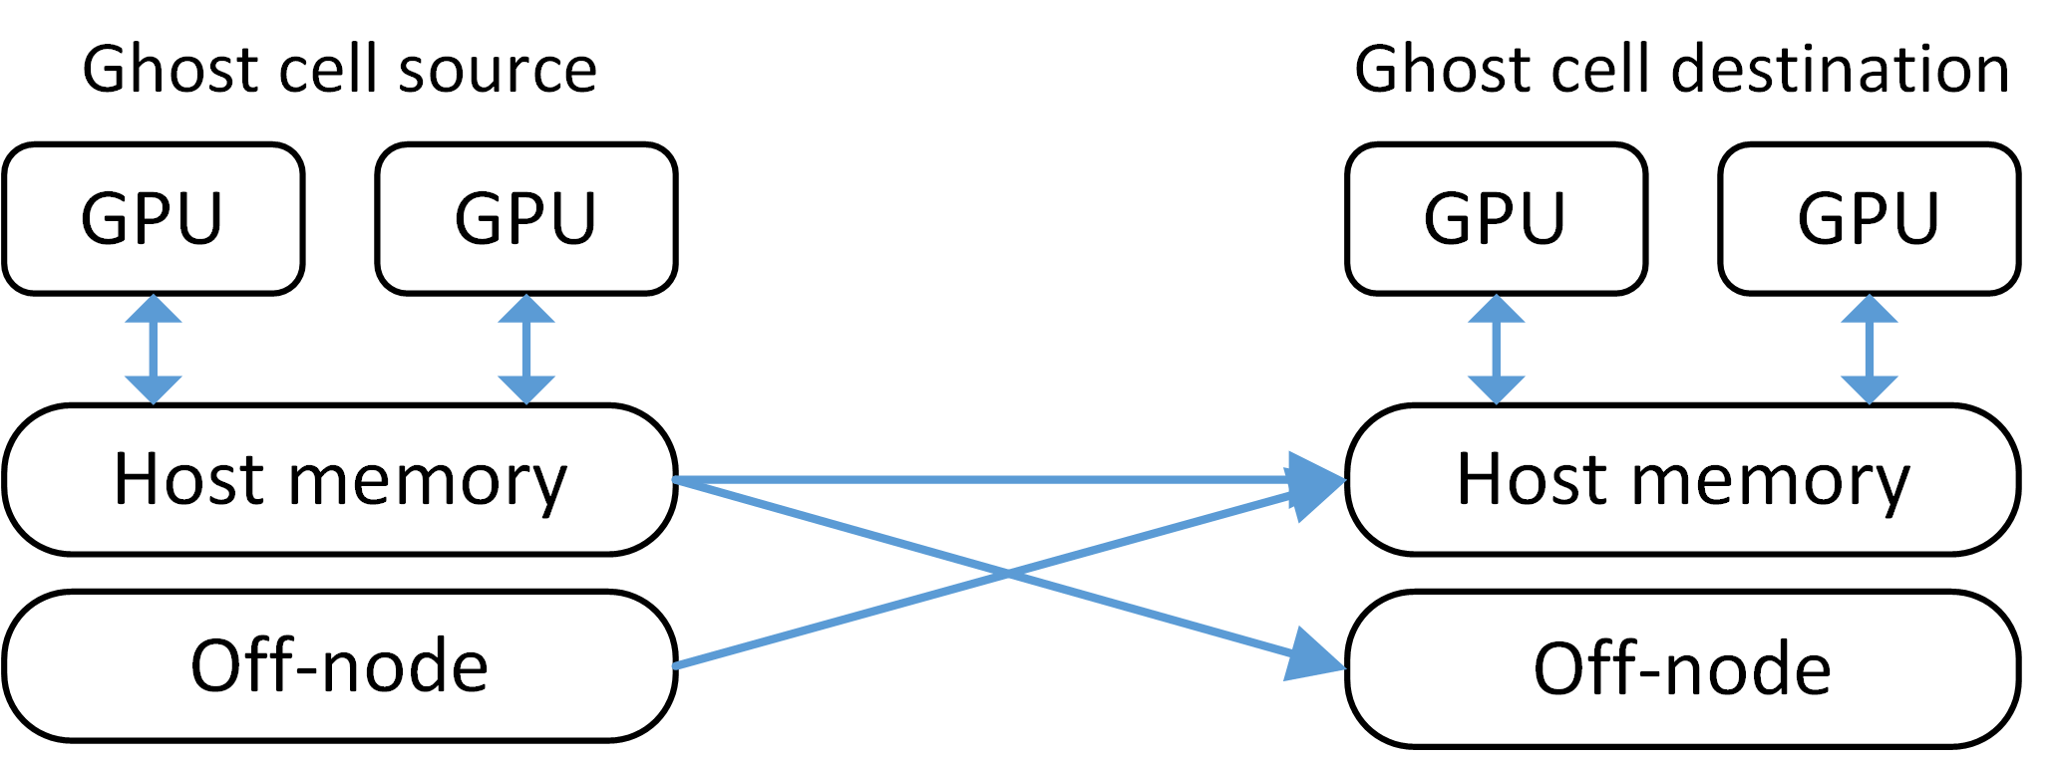
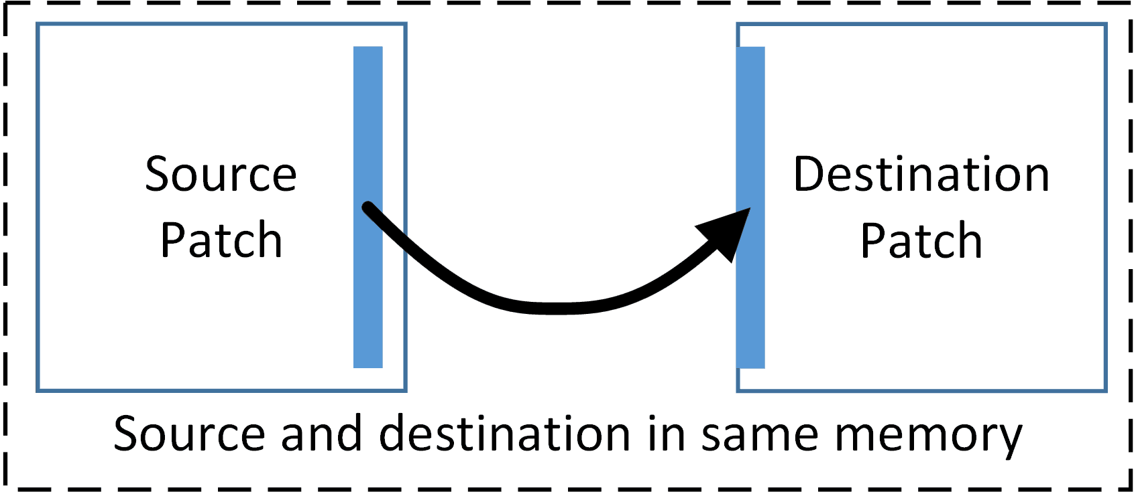
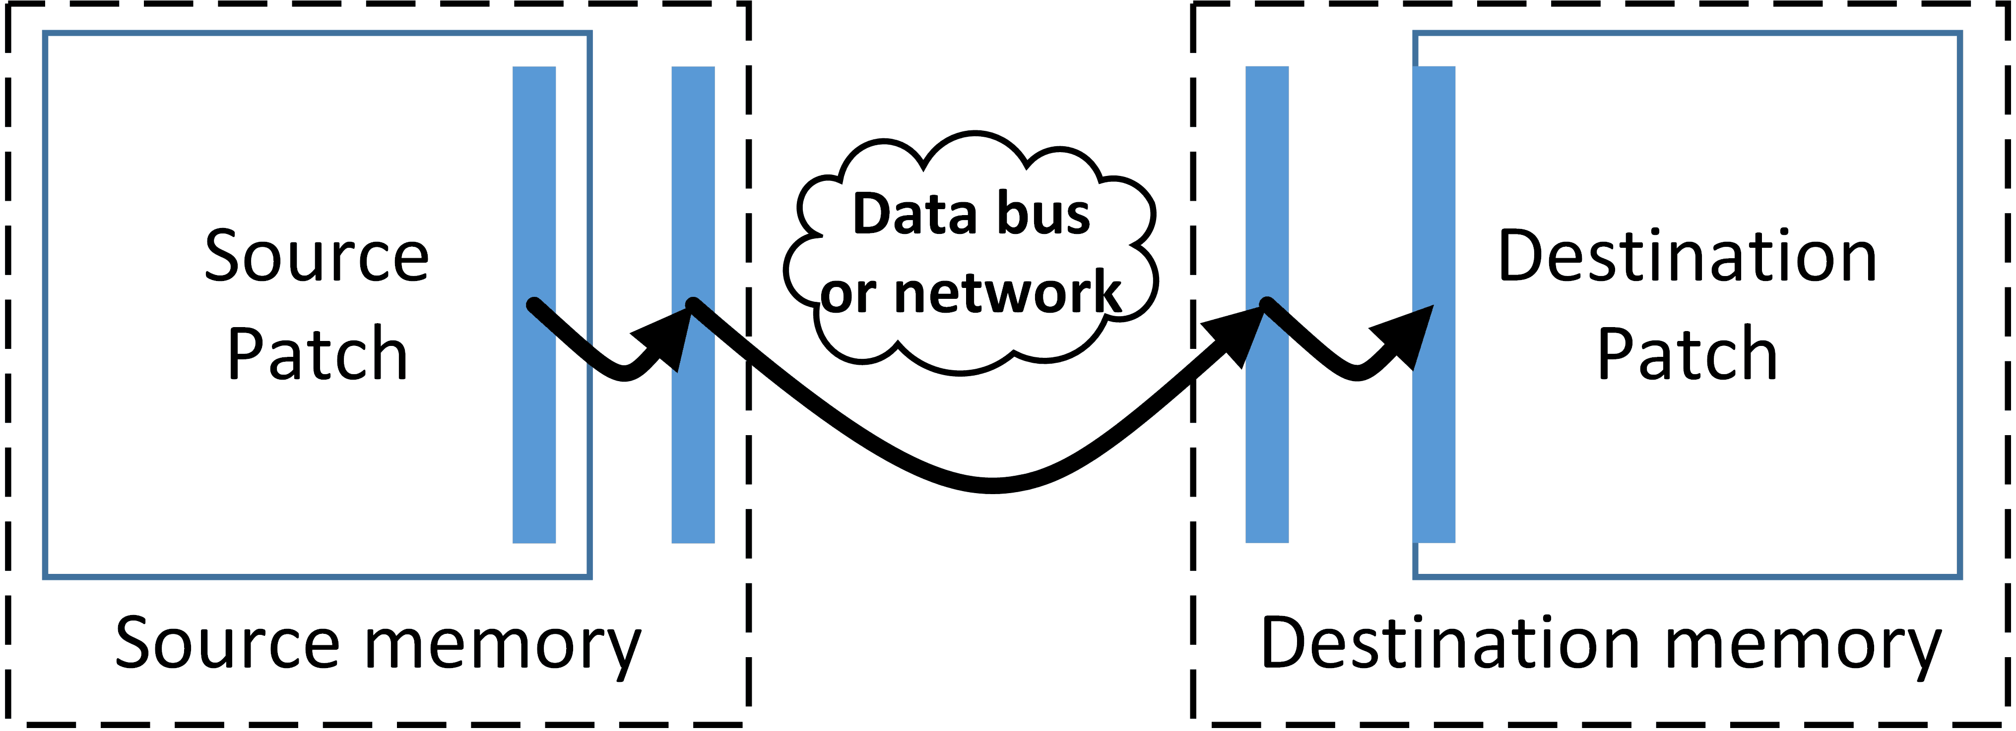
Halo Gathers in GPU memory
Before, all halo gathers happened in host memory
Copying changed so halos can copy within the same memory region
Halo buffers also sent into GPU memory if simulation variable resides there.

Slide 40
Defining Portable
Kokkos
Run Kokkos enabled tasks on GPUs, CPUs, and Xeon Phis with minimal architecture specific requirements in task code.
Task API
Preserve application layer API with minimal GPU runtime interaction.
Data Warehouse API
Keep data warehouse logic uniform for host and GPU memory.

Slide 41
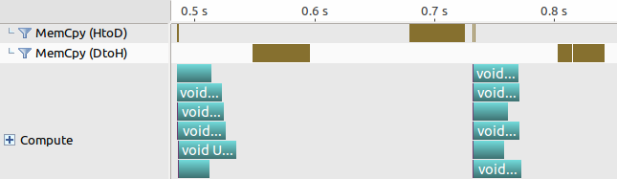
Defining Performant
Low wall time overhead (in milliseconds) for task preparation.
Lower memory usage due to data sharing.
Similar Kokkos and non-Kokkos tasks execution wall times should be comparable.
Note: Kokkos can’t force performant code, and users can still write slow code!
Before:
After:
Before:
After:

Slide 42
Future Work - Complete Kokkos Modifications
Complete Kokkos::parallel_reduce modifications for asynchrony.
Mostly polishing and minor features.
Investigate register usage restriction.
CUDA has had it for years.
We used it for big performance gains on last year’s Titan runs.
Kokkos just introduced a feature to support this.

Slide 43
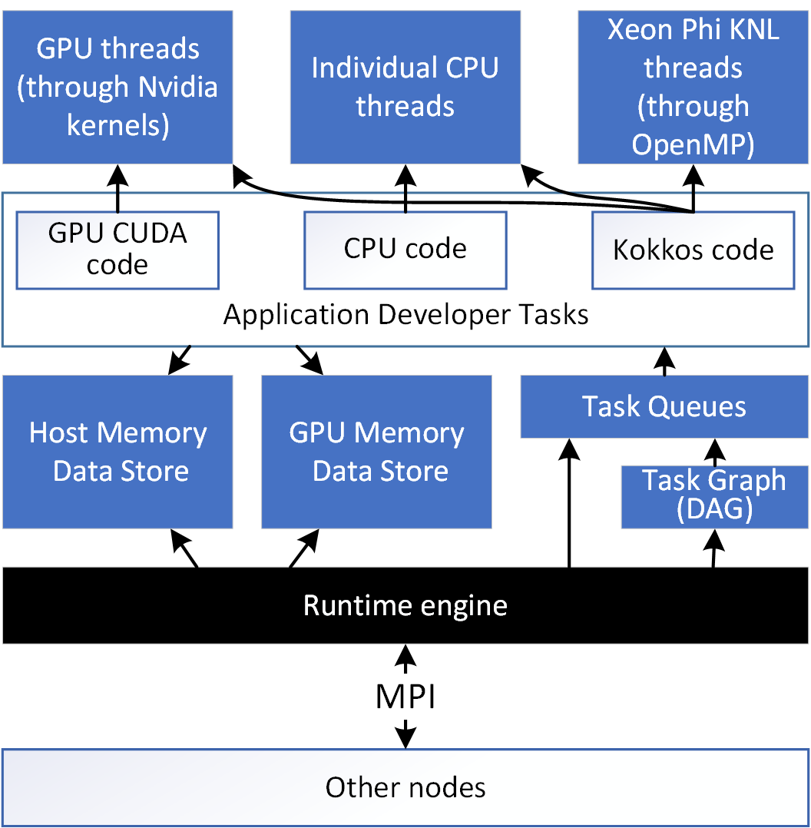
Uintah Overview - Continued
Structured mesh grid partitioned into uniform patches
Patch contains many cells
Tasks/variables assigned to patches
One node is assigned many patches
One MPI rank per node
Halo exchange with MPI rank neighbor
All CPU threads involved in scheduling and execution
Notes:
Above image shows 27 patches in a node.
Within a patch could be individual cells. Common sizes of an individual patch are 16x16x16 or 32x32x32.
Give an example. Suppose we had 12,000 nodes, and 16 logical GPU cores on each node. At one patch per core, that allows for 192,000 patches. At 32^3 per patch, 6291456000 cells, that's roughly 1800x1800x1800 simulation.
Uintah operates on fixed timesteps. At the beginning of a time step, Uintah's runtime engine sends out all ghost cells to neighbor MPI ranks. It is then constantly processing any incoming ghost cells.

